Slide 1
Best places to open a gym in New York City Based on Foursquare Data
By Ricardo Bermúdez

Slide 2
Introduction
Gyms are the go to place for people seeking a healthy life style, most used to go to the gyms after the work day is over, but with the covid-19 pandemic and work from home this routine has been hit very hard, people no longer could go to the gyms and if they could they found out that they would now have to make long trips to attend to the gyms they used to. With this in mind we explore these 3 questions:
-What is / are the best location(s) for a Gym in New York City?
-In what Neighborhood and/or borough should the investor open a Gym to have the best chance of being successful?
-Where would I go in New York City to find the best Gym?

Slide 3
Data acquisition and cleaning
To find the best place to open a gym I will use the following data sources:
- A New York City dataset obtained from https://cocl.us/new_york_dataset containing the neighborhoods, and boroughs of the city along with the respective latitudes and longitudes that will be needed, this information will be cleaned and processed into a dataframe.
- Gym data, ranging from location and names to ratings and likes, will be acquired from the FourSquare API and listed in dataframes from highest to lowest.
- The Average Annual Population of NYC Neighborhoods, 2013-2017 obtained from https://www.health.ny.gov/

Slide 4
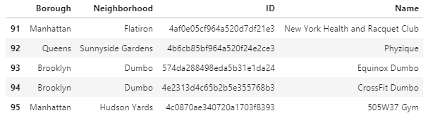
Exploratory Data Analysis
With the help of the Foursquare API I acquire the gyms present in each neighborhood, and arrange it:

Slide 5
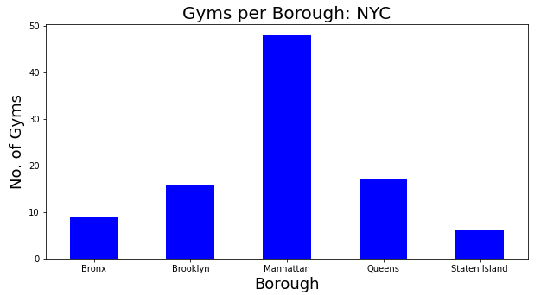
Most Gyms are in the Manhattan Borough

Slide 6
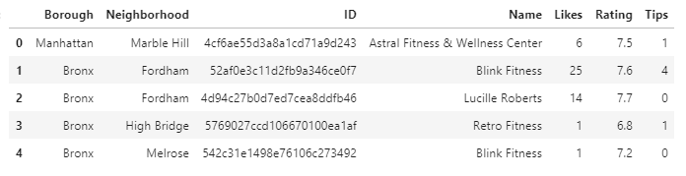
Using the Foursquare API we collect detailed information of our gyms

Slide 7
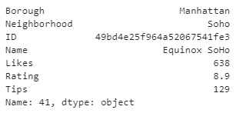
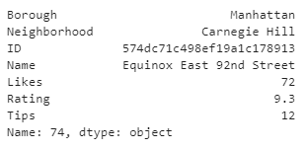
With this we can find which gym has the most amount of likes, tips and highest rating.
The Soho in Manhattan has the most amount of likes and tips, while the equinox East 92nd Street has the highest rating

Slide 8
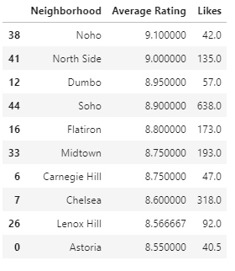
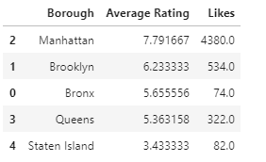
Top ten rating per Neighborhood and Borough

Slide 9
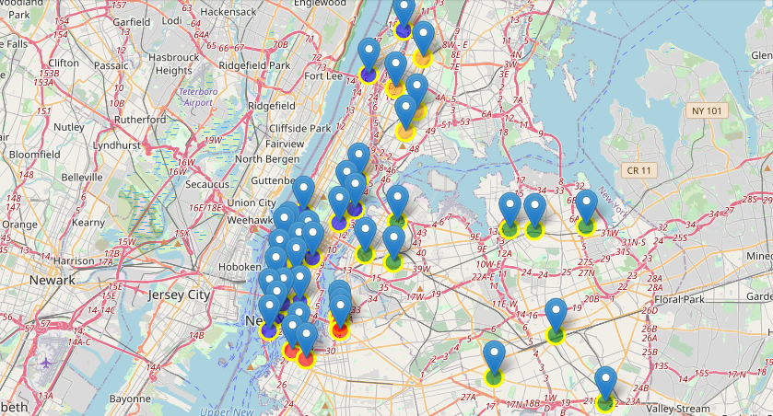
Gyms with a rating higher than 7.0
Manhattan Queens
Brooklyn Bronx

Slide 10
Conclusions
Currently the most Gyms are in Manhattan but if we take into consideration the population of each borough and the population that now work from home due to covid-19 several places come into mind as good places to open a new gym and each with its advantages and disadvantages.
Opening a Gym in Manhattan. Manhattan as mentioned before is currently the go to place for the best gyms, but new gyms in this area would be up to a fierce competition due to the amount of gyms that are already present in the area, but if investors believe they can be up to the challenge a new gym in the borough will have their clientele assured.
Opening a Gym in Brooklyn. This Borough has a higher population than any other so taking into account the previously mentioned population working from home, along with the fact that this borough has few gyms with high rating in them, and the ones they have are closer to the Manhattan Borough, this conditions offer a great opportunity for new gyms, some good neighborhoods for this possible gym could be Flatbush, Kensington or prospect lefferts gardens all with a somewhat centric location in Brooklyn

Slide 11
Future directions
Through this project a look of the potential places to open gyms was taken, taking in mind information from the Foursquare platform and population census from 2019 of New York City boroughs. For future projects more detailed information can be acquired to get a better understanding about the gyms and what makes them popular, what do people want in their gyms, what makes a successful gym aside from location?
A profile of the clients can also be made, taking into consideration age, gender, income, etc. And figure out what type of people are most likely to go to gyms, to figure out their specific market, cross examine the finding of the people likely to go to the gyms with profiles of people working from home is there or is there not a relation between the two? Overall this and many other improvements could be made to the project giving us a better understanding to where and how to open a gym in New york city.

